Slide 1
Wireless Hacking Tools

Slide 2
Presenting :
Ahmed Alaa Eldin Abdelwahab
AbdElghani Muhammad AbdElghani
AbdAallah Ramadan
Ahmed Abdellatif Mhana
Ahmed Magdy Mohamed Zaki

Slide 3

Introduction :
Wireless Technology
Notes:
There are about 10 million Wi-Fi networks around the world, most are unsecured and open to unauthorized use because many individuals’ and businesses don't understand how to secure a wireless network and also because many Wi-Fi products come ready-to-use right out of the box.

Slide 4

Types of attacks on wireless technology :
Confidentiality
Integrity
Availability
Bluetooth
Notes:
Confidentiality attack tools focus on the content of the data and are best known for encryption cracking.
Integrity attacks tools focus on the data in transmission and include frame insertion, man in the middle, and replay attacks.
Availability attack tools focus on Denial of Service (DoS).

Slide 5
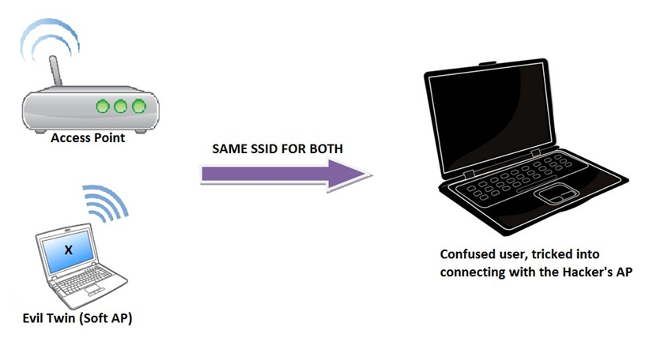
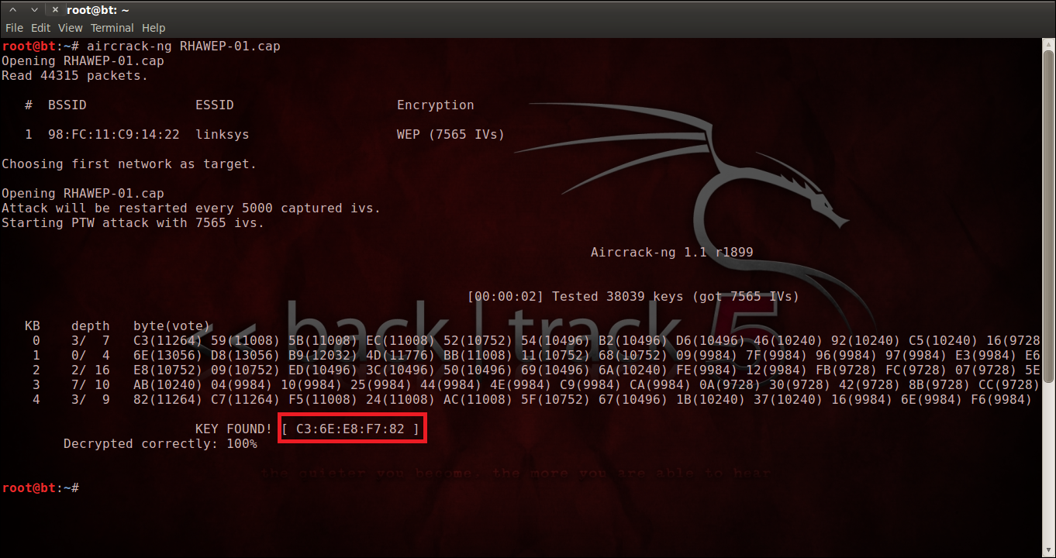

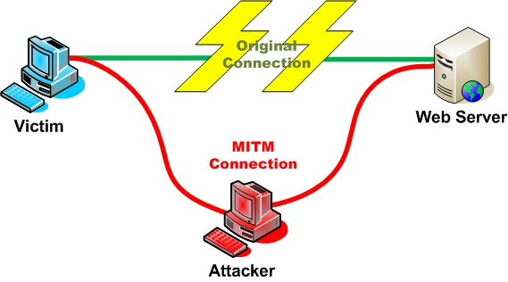
Confidentiality Attacks Types :
Eavesdropping
Key cracking
Access point phishing (Evil Twin Attack)
Man in the middle (MITM)
Evil Twin
Notes:
Eavesdropping is gathering information from a network by snooping on transmitted data, overhear a private conversation over a confidential communication in a not legally authorized way. The information remains intact, but its privacy is compromised.
Key cracking: is having the wireless protection key.
Access point phishing (Evil Twin Attack): is the wireless version of the phishing scam. An attacker fools wireless users into connecting a laptop or mobile phone to a tainted hotspot by posing as a legitimate provider.
Man in the middle : is a form of active eavesdropping in which the attacker makes independent connections with the victims and relays messages between them, making them believe that they are talking directly to each other over a private connection, when in fact the entire conversation is controlled by the attacker.

Slide 6
Tools :
Wireshark
Ettercap
dsniff
Hottspotter
Apsniff
APhunter
KNSGEM
HermesAP
OpenAP
OpenWRT
HyperWRT
Notes:
1 - It is a basic sniffing program that will display all network traffic both wired and wireless. It is a multi-platform, multi-protocol analyzer . ^{[2]} with hundreds of protocols supported. Display the captured data in an easy to read and easy to follow form. It also has many built in filters and the ability for the user to design their own filters. These filters can be used to only capture specific data such as a certain IP address, protocol, port number, etc.
2&3 - Are two Linux based programs popular man in the middle attack tools. They both provide sniffing capabilities similar to Wireshark, but go beyond that with the ability to modify the data in transmission.
4 - passively monitors the network for probe request frames to identify the preferred networks of Windows XP clients, and will compare it to a supplied list of common hotspot network names. If the probed network name matches a common hotspot name, Hotspotter will act as an access point to allow the client to authenticate and associate.
5 - is a wireless (802.11) access point sniffer. It enables you to list all access points broadcasting beacon signals at your location. To help you set new access points making sure you do not have interfering APs. To help you set-up wireless clients by providing you with the client configuration information.
Summing - All previous four programs will scan for wireless AP beacon signals. Although they are not necessarily attack tools, they can be used to find the wireless APs. KNSGEM will even place the APs on a Google Earth map. Attackers will then setup their evil twin AP near these legitimate ones.
7&8 - Are two Linux based tools that allow the user to setup phony Aps.
9&10 - Are two open source projects that replace the factory firmware for Linksys's popular WRT Line of APs. Attackers can use these distributions to create fake APs.

Slide 7

Integrity Attacks Types :
Frame injection
Notes:
When communicating with a web server there is a delay of tens of milliseconds while waiting for a reply. This is plenty of time for spoofed packets to be injected and the legitimate packets to be deleted.
What Can I Do With It ?
User would access their banking web page and it would look like their legitimate web page
Generate a DoS attack Packet injection tools can be used to issue deauthenticate . ^{[6]} messages for the IP addresses in the network
Delete or jam the data being transmitted an attacker could jam the wireless signal from reaching its intended target
attacker capturing authentication information and saving it for later use once the attacker has captured and saved the authentication information

Slide 8
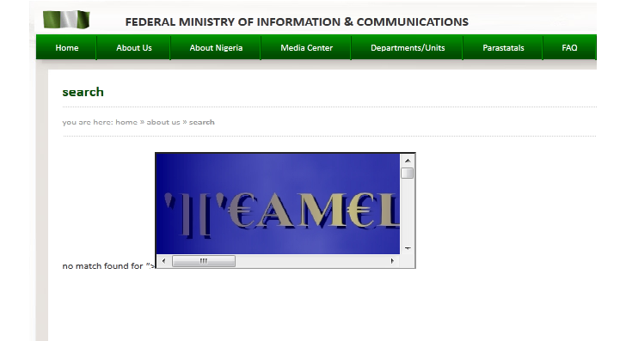

Tools :
Airpwn
File2Air
Simple replay
Notes:
1 - Airpwn is a framework for 802.11 (wireless) packet injections. Airpwn listens to incoming wireless packets, and if the data matches a pattern specified in the config files, custom content is injected "spoofed" from the wireless access point. From the perspective of the wireless client, airpwn becomes the server.
2 - File-Based Wireless Packet Injection tools except it allows the user to specify a file that will be used for the payload of the injected packets. It uses another tool called AirJack to perform the actual frame injection. File2air runs on top of AirJack and reads in a binary file and transmits its contents onto a wireless network.
3 - an attack tool that allows for 802.11 packets that were previously captured to be injected back into the network.

Slide 9
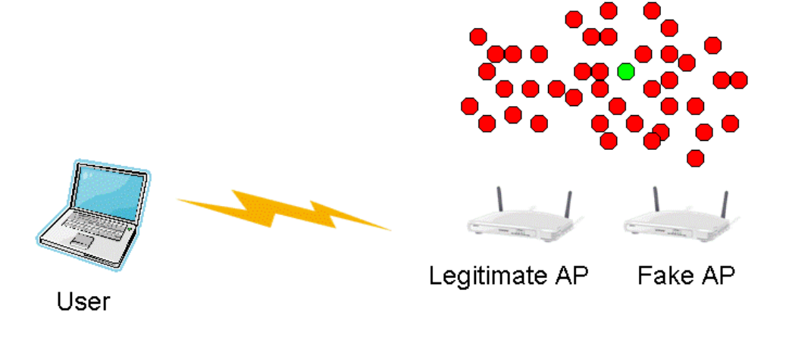
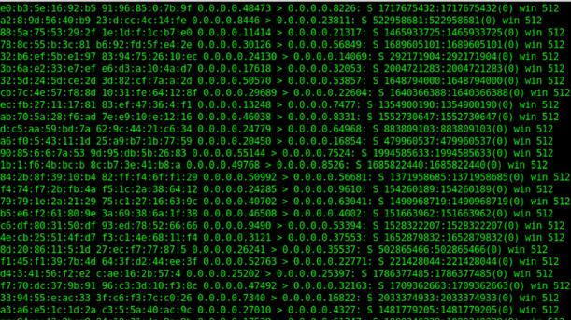
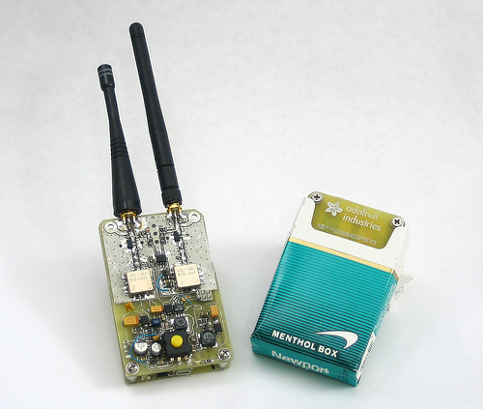
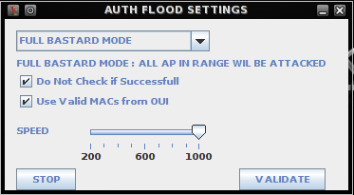
Availability Attacks Types :
Flooding
Authentication Flood
Beacon flood
Radio frequency jamming
Notes:
Flooding: is overloading the network with a certain type of packet so that the wireless AP is busy serving all the flooding packets that it cannot serve any legitimate packets.
Authentication Flood: where thousands of authentications are sent from random Media Access Control (MAC) addresses filling up the AP's authentication table and making it hard for a legitimate user to gain access.
Beacon flood: is where thousands of illegitimate beacons are generate to make it difficult for individual machine to find the legitimate AP.
Radio frequency jamming: jams the frequency of the Wireless Local Area Network (WLAN) most likely with a much higher power level allowed by the regulation. This will not allow anyone access to the WLAN.

Slide 10
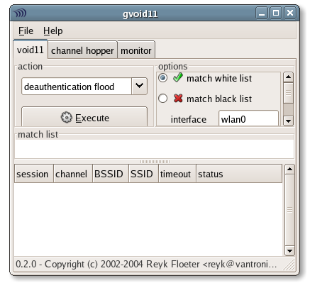
Tools :
FakeAP
Gvoid11
Notes:
1 - generates thousands of 802.11 APs or more specifically it generates thousands of 802.11 beacon signals that can be used for the beacon signal flooding attack.
2 - flooding attack tool has the ability to implement three different flooding attacks: deauthenticate clients, deauthentication flood, and association flood. The deauthenticate attack floods the WLAN with deauthenticate packets for random MACs.

Slide 11

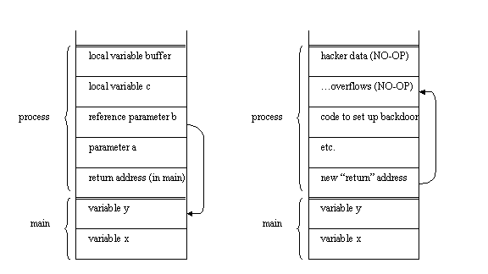
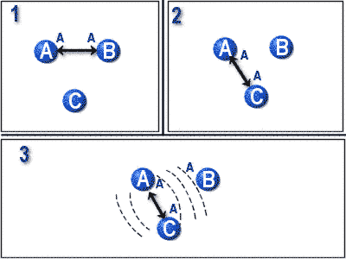
Bluetooth Attacks Types :
DoS attack
Buffer overrun
Bluesnarfing
Key bump
Notes:
1- involves a device that is not part of a piconet disrupting the established piconet of other devices, A Bluetooth piconet is the ad hoc network created with two or more Bluetooth devices that includes one master device and a number of slaves. The attacking device that is not participating in the piconet spoofs a slave out of the piconet and then contacts the master of the piconet. This will confuse the master device and lead to a disruption of the piconet.
2- This is when data is copied into a buffer, but the amount of data copied into the buffer exceeds the size of the buffer. This will cause the data to be copied into memory where it is not intended. The resulting status of the system depends on where in memory the data is copied.
3 - means obtaining unauthorized information through a Bluetooth connection. The Object Exchange (OBEX) ^{[18]} Push Profiler (OPP) has been identified as an easy mechanism for exchange of business cards, calendar entries, and other similar items. This service does not require authentication.
4 - Gets the victim to accept a connection for some trivial data transfer, such as a picture, calendar notice, or a business card on a PDA. After the data is sent, the attacker keeps the connection open. This allows the attacker to request a key regeneration after the victim has deleted the pairing between the two devices. Once the key regeneration is done, the attacker has full access to any services provided by the victim's device.

Slide 12
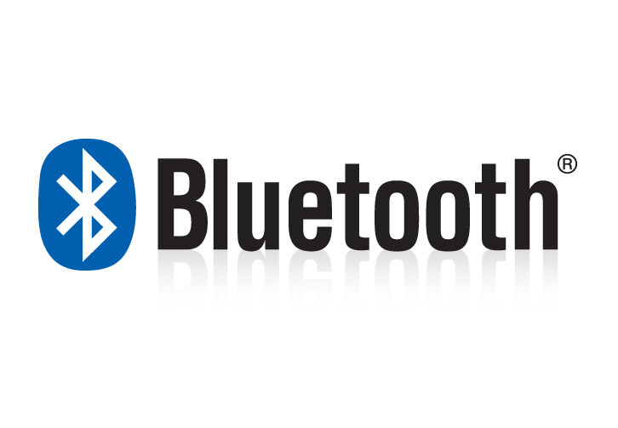
Tools:
BlueSmack
BlueSnarf
BluePass
BlueBump
Notes:
1 - Bluetooth attack that knocks out some Bluetooth-enabled devices immediately. This Denial of Service attack can be conducted using standard tools .
2 - Obtain unauthorized access to files.
3 - Causes a buffer overflow attack.
4 - Obtains the piconet key.

Slide 13

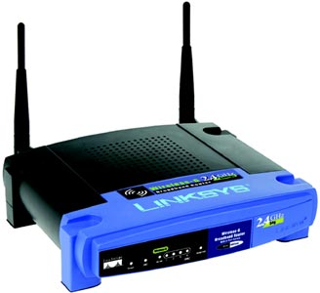
Protection Tips :
Change the Administrative Password on your Wireless Routers
Installing a Firewall
Change the Default SSID Name and Turn off SSID Broadcasting
Disable DHCP
Replace WEP with WPA
Accept Only Trusted Bluetooth Connections
Don’t Leave Your Bluetooth Open ☺

Slide 14

Any
Questions ?

Slide 15
THANK YOU

